Slide 1
Topic Modeling and Cosine Similarity-Based Content Recommendation Engine for the Criterion Channel
Aaron Tan, Prashant Mourya

Slide 2
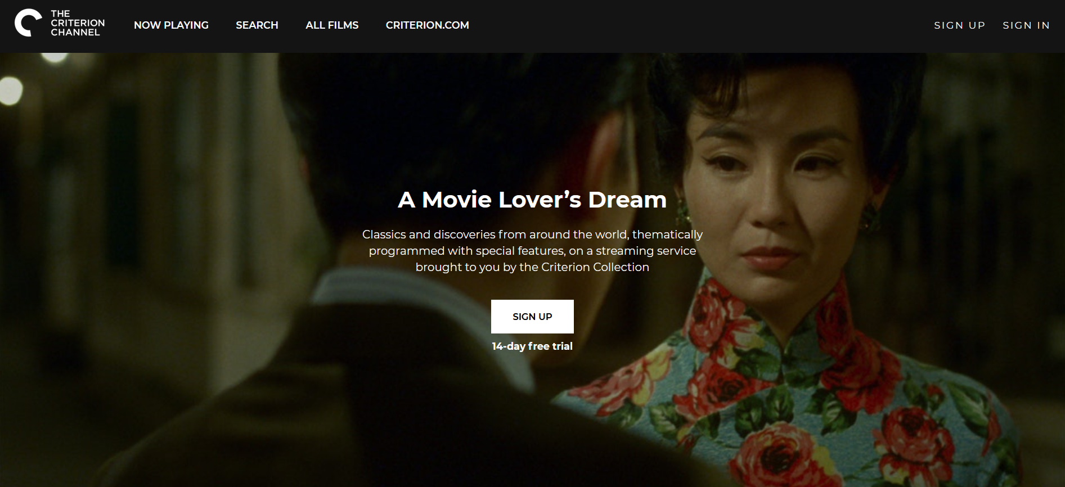

Slide 3
Introduction

Slide 4
NLP Concepts

Slide 5
Why Content-Based Recommendation

Slide 6
Text Preprocessing

Slide 7
Count & TD-IDF Vectorization

Slide 8
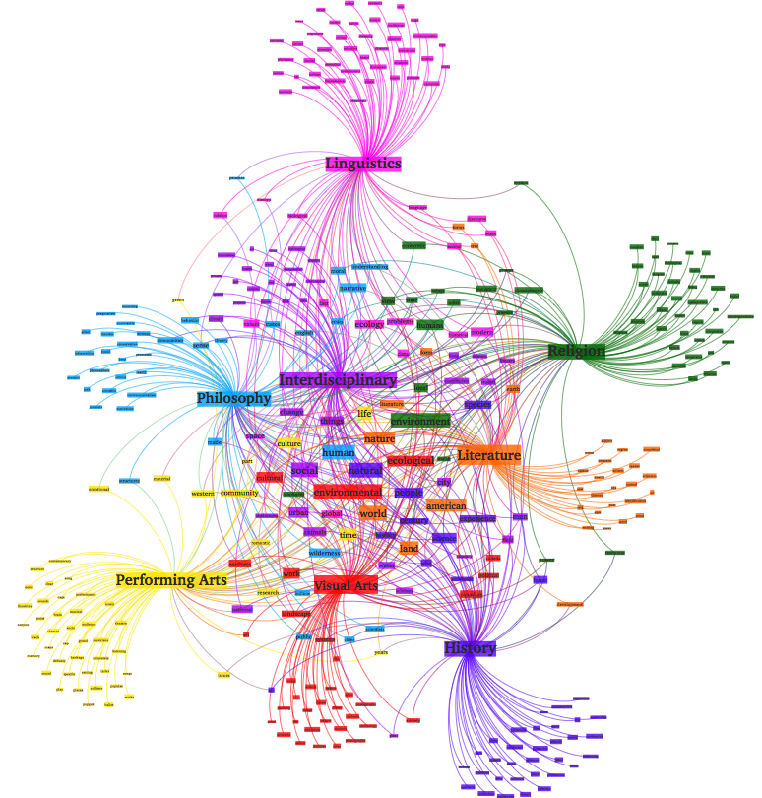
Topic Modeling
Latent Semantic Analysis/Indexing (LSA/LSI)
Dimensionality reduction using singular value decomposition
Topics are “reduced” representations of documents in the corpus
Latent Dirichlet Allocation (LDA)
Generative statistical model using Bayesian Dirichlet priors
Topics are latent sources that “produce” documents as mixtures of topics, which are mixtures of tokens
Mathematics aside, LDA is generally known to produce more interpretable and coherent topics

Slide 9
Cosine Similarity

Slide 10
Project Summary

Slide 11
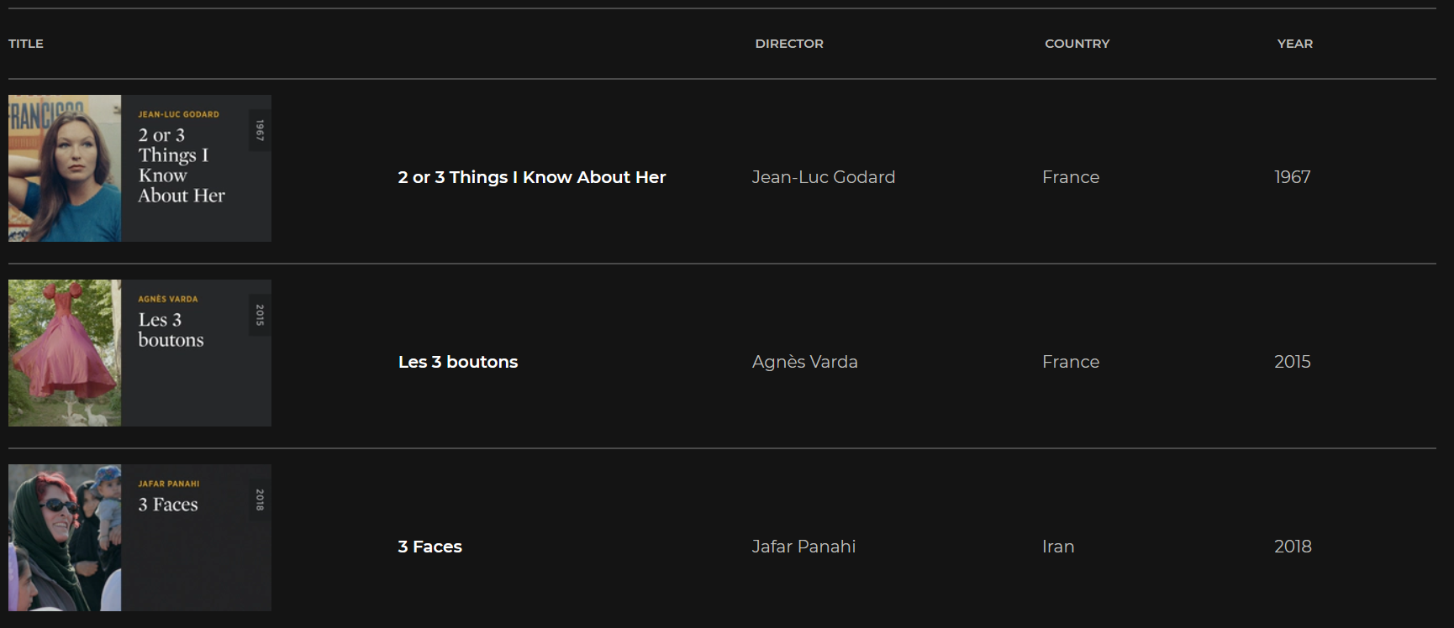
Data Collection & Webscraping From This:

Slide 12
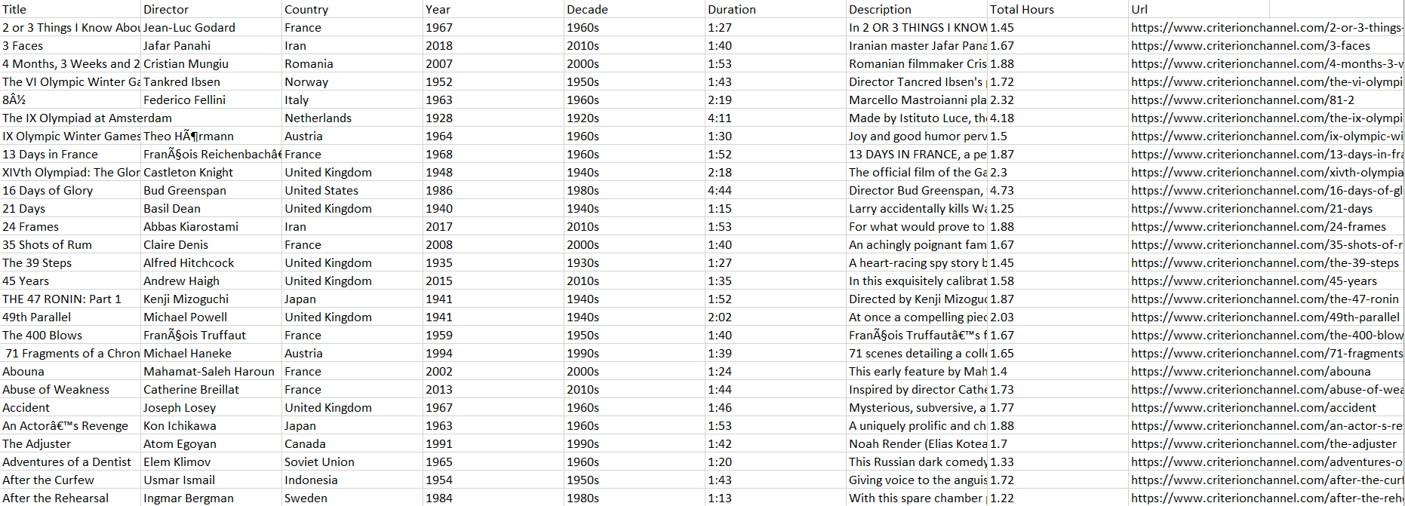
Data Collection & Webscraping To This:

Slide 13
Merging with IMDB Ratings Dataset
To obtain average user ratings for each film in the Criterion Channel
String matching
FuzzyWuzzy and Levenshtein Distance (minimum number of single-character edits (insertions, deletions or substitutions) required to change one word into the other)
Comparing pairs of strings between one dataset of ~1,000 rows and another of ~1,000,000 rows is computationally intractable
String Grouper
A Python package that accomplishes string merging by comparing a target string from one dataset to the TF-IDF matrix of another dataset – outputs a list of strings from the other dataset ordered by cosine similarity

Slide 14
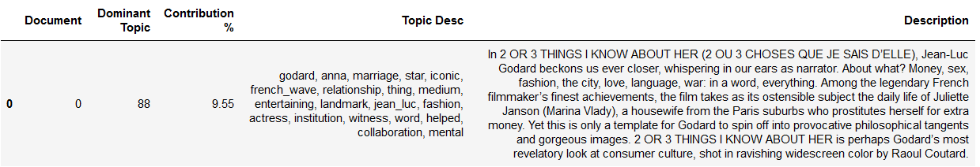
LDA Topic Modeling Using Mallet
Mallet - an extremely fast and highly scalable implementation of Gibbs sampling, efficient methods for document-topic hyperparameter optimization, and tools for inferring topics for new documents given trained models
Unigram + bigram model, 100 topics

Slide 15
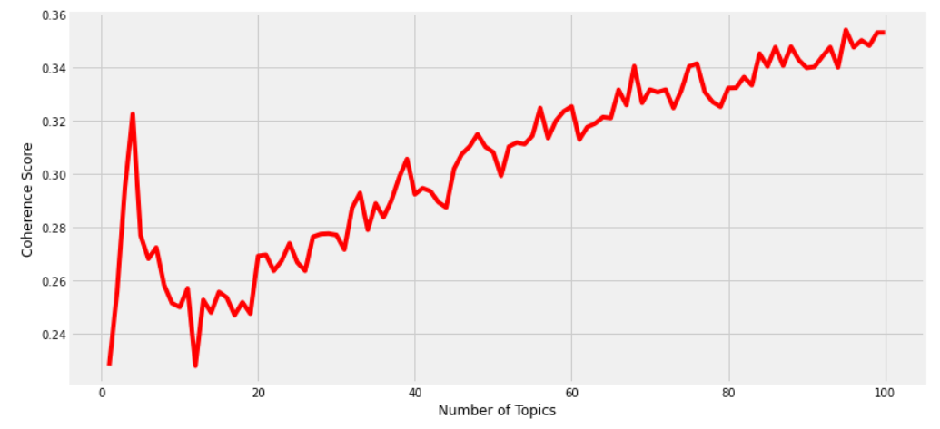
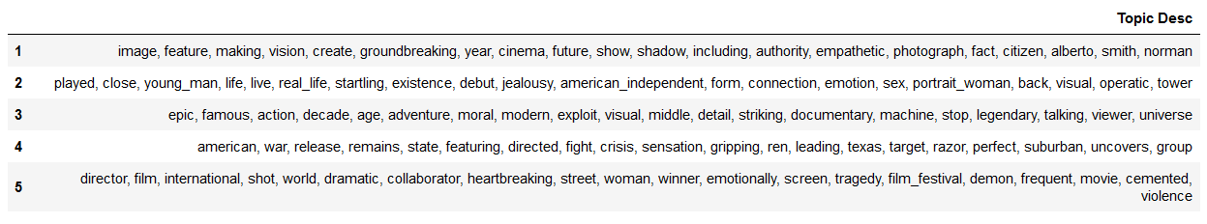

Slide 16
Recommendation Engine
Implemented with ipywidgets and Voila
Enter film from the Criterion Channel
Scroll through 1st, 2nd, 3rd, etc. top recommendations from the topic modeling and/or cosine similarity recommendation engine
The app provides meta-data, description, IMDB rating/# ratings, and URL to explore new films to watch

Slide 17
